Slide 1
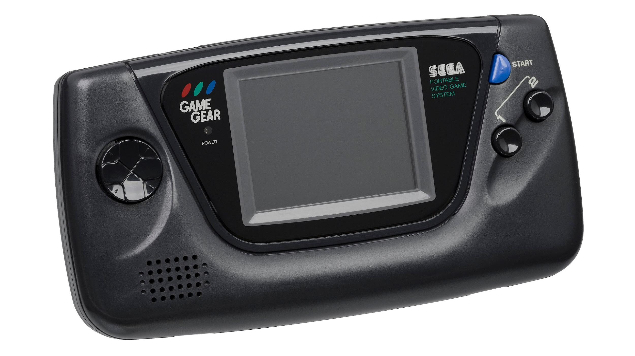
Gamification as a Trend in the Instructional Design and Technology Field
Morgan Culp

Slide 2
Brief IDT History
Instructional Design was transformed during WW2
Started off as “visual instruction”
Audio elements were added to create a more “full” picture of instructional design
Was later adopted as a process of instructional design

Slide 3
Gamification throughout time: Leveling Up
1896
1908
1973
Businesses started seeking out ways to keep customers coming back.
S&H Green Stamps was the first company to enact a “loyalty program” which rewarded repeat customers with a stamp.
The Boy Scout Foundation was formed.
The badge and leaderboard elements of gamification were displayed throughout one's journey in Boy Scouts
The Game of Work was written and released by Charles Coonradt.
He saw declining employee engagement as a way to add “fun and games” to the workforce and engage employees.
Notes:
https://www.growthengineering.co.uk/history-of-gamification/

Slide 4
Leveling Up
1978
1980s
2002
The beginning of social video games.
MUD1 was created, the first multi-user dungeon game. This was the start of today’s social online gaming realm.
Researchers see how academics could benefit from gaming.
Articles emerge exploring what could be learned from computer games and how they can target and practice skills.
‘Gamification’ is born.
Nick Pelling is a game designer who coins the word gamification and creates a game like interface for tasks such as ATM, vending machines and other electronics.

Slide 5
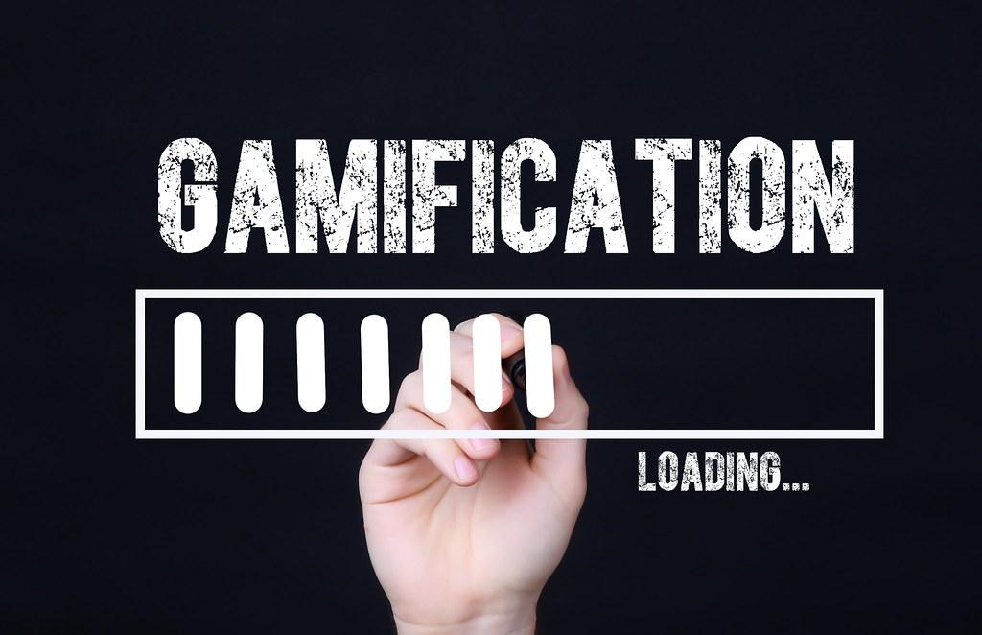
Gamification
Webster defines Gamification as: the process of adding games or game-like elements to something (such as a task) so as to encourage participation.
Defined
Notes:
https://www.merriam-webster.com/dictionary/gamification

Slide 6

Gamification Today

Slide 7
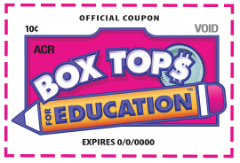
Throughout the progression of the 2000s, gamification has entered daily aspects of our life and what we see on our cell phones, in the classroom and in daily activities.
Marketing companies around the world have utilized gamification techniques to get interactions from consumers and leave them with their product in mind to share on social mediums for example interactive Snapchat filter ads.
My first memory of gamification in my youth growing up was collecting box tops (program started in 1996) off of products to turn in for prizes at school. I can see how large marketing strategies like this can appeal to children and young people.

Slide 8
How has IDT been affected?
Gamification strategies have been shown to boost motivation and a learners self-regulation.
Game elements are also found as more “entertaining” than a strict lecture style of ID and can keep an attention span for longer.
Studies have been done in K-12 classrooms, and into higher education.
  Think back to the interactive activity in class where we went onto the K-12 open resources link and found mainly games and fun interactives for students to study.
The Self-Determination Theory (Ryan and Deci, 2000) is how gamification should be designed and utilized by using relatedness, competence, and autonomy to increase a learner's motivation–both intrinsic and extrinsic.
Notes:
Fotaris, P., Mastoras, T., Leinfellner, R., & Rosunally, Y. (2016). Climbing up the
leaderboard: An empirical study of applying gamification techniques to a
computer programming class: EJEL. Electronic Journal of E-Learning, 14(2),
94-110. Retrieved from
http://search.proquest.com.esearch.ut.edu/trade-journals/climbing-up-leaderboar
d-empirical-study-applying/docview/1804471664/se-2

Slide 9
Has Gamification been affected by another trend?
Gamification has been affected by the rising trend of social media.
  I believe that these two trends, couples together, could reap many benefits in interaction and self-regulation.
  Take Yellowdig, for example. The social medium for sharing information and expanding upon knowledge uses gamification with the points system. It is a goal for each of us each week to reach a certain number on that point scale which in turn raises our motivation to become conversant on the social medium platform and leads to more interaction.

Slide 10
Rebrand: Gamification into “FUNction”
If I were to rename and market gamification, I would get rid of the lengthy and sometimes confusing term ‘gamification’ and market the trend called ‘FUNction.’
Fun is often overlooked in educational contexts but it is one of the key motivators for students and it is how gamification has become so popular, by adding ‘fun’ to an otherwise mundane activity.
Notes:
https://www.degruyter.com/document/doi/10.1515/icom-2021-0025/html?lang=de

Slide 11
FUNction
Gamification is a very large trend in the IDT field, so I would narrow my new trend FUNction down to gamification within an educational context.
Students need to be engaged in their activities and knowledge to become interested in learning the topics they must master. If a student hears they will be doing a ‘FUNction lesson’ the name alone will strike their interest and get the initial “attention getting” step of Gange’s 9 events of IDT.

Slide 12
Advertising FUNction
I would advertise FUNction to parents of grade school children via Facebook and TV ads.
FUNction will be a service that parents can use with their children outside of school as a tutoring aid with interactive lessons and games using many gamification and computer game techniques.
Teachers and schools would also have the opportunity to purchase and implement these online interactive study tools in their classrooms.

Slide 13
Why Gamification?
I work in admissions at UT and work will high school students who are looking to get into higher education on a daily basis. We have conversations about test scores and their grades, and are always looking for ways to improve.
I am a big fan of gamification techniques in a classroom and school setting. Based off of my own school journey, I have found many gamification elements impactful in my education.
  Kahoot, Digital flashcards, Cool Math Games, Jeopardy, Point systems, Reward systems, the “treasure box” in elementary school, and so many others.
I have been focusing on gamification in higher education and was intrigued to discover what motivates college aged students to become so invested in trends such as gamification.

Slide 14
Strategy for permanence of Gamification in IDT
Linking gamification to current and future trends in IDT to strengthen the instruction.
Online/Distributed learning- adding gamified lessons for virtual school/blended learning.
Artificial Intelligence- coupling these trends could be used by practicing the needed instruction multiple times and being rewarded points for doing well.
Simulation- adding games and more interaction.
Virtual worlds and social media- leaderboard to engage friendly competition.

Slide 15
Successful Company using this now:
MindSpace is a company currently creating gamification marketing strategies for clients. Examples include:
Employee onboarding + training Boost retention and turn content into skills. Learn More
Interactive marketing + product launches Grab and hold attention with brand-focused experiences. Learn More
Event strategy + design Attract, educate and activate your audience. Learn More
Advanced gamification Motivate, increase engagement and add value to your content.
Customer education + loyalty programs Delight, teach and gain lifelong advocates. Learn More
Sales enablement tools Train and motivate a busy sales force. Learn More
Notes:
https://www.mindspace.net/gamification?utm_term=gamification&utm_campaign=Gamification&utm_source=adwords&utm_medium=ppc&hsa_acc=2915573878&hsa_cam=98911272&hsa_grp=65351715525&hsa_ad=333234183827&hsa_src=g&hsa_tgt=kwd-21445406077&hsa_kw=gamification&hsa_mt=p&hsa_net=adwords&hsa_ver=3&gclid=Cj0KCQjwl7qSBhD-ARIsACvV1X0FdCK00To8jp4FmoBE-cGmSOWEmrOnz0GVLWe9UenYyKbaHid8ItcaApuJEALw_wcB

Slide 16
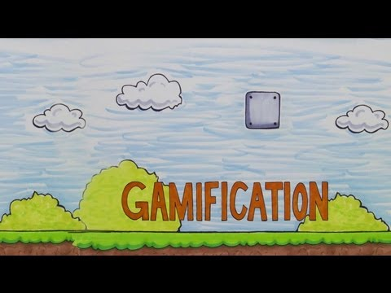

Slide 17
Sources
Fotaris, P., Mastoras, T., Leinfellner, R., & Rosunally, Y. (2016). Climbing up the
leaderboard: An empirical study of applying gamification techniques to a
computer programming class: EJEL. Electronic Journal of E-Learning, 14(2),
94-110. Retrieved from
http://search.proquest.com.esearch.ut.edu/trade-journals/climbing-up-leaderboar
d-empirical-study-applying/docview/1804471664/se-2
Imran, H. (2019). Evaluation of awarding badges on Student’s engagement in gamified
e-learning systems. Smart Learning Environments, 6(1), 1-12.
doi:http://dx.doi.org/10.1186/s40561-019-0093-2
Jayalath, J., & Esichaikul, V. (2020;2022;). Gamification to enhance motivation and
engagement in blended eLearning for technical and vocational education and
training. Technology, Knowledge and Learning, 27(1), 91-118.
https://doi.org/10.1007/s10758-020-09466-2
Subhash, S., & Cudney, E. A. (2018). Gamified learning in higher education: A
systematic review of the literature. Computers in Human Behavior, 87, 192-206.
https://doi.org/10.1016/j.chb.2018.05.028
Tegtmeier, T., Neofotistos, S., & Noormohamed, N. A. (2013). How gamification rewards
college-aged consumer loyalty: One click at a time. Competition Forum, 11(2), 177-184. Retrieved from http://search.proquest.com.esearch.ut.edu/scholarly-journals/how-gamification-rewards-college-aged-consumer/docview/1756026730/se-2?accountid=14762

